Slide 1

Patient condition classification and drug recommendation based on drug reviews
By,
Anju Jadhao

Slide 2
Table of content
Introduction
Objective
Work Flow
Data explanation
Tools and Algorithms used for project
Data Preprocessing
Data Visualization
Data Partition
Model Train and Test Accuracy
Deployment
Challenges and its solution
Advantages
Conclusion
Scope

Slide 3
Introduction
Social media contains a large amount of information with user sentiment and opinion across different field.
Drug review.com website provide users textual reviews and numeric ratings of drugs.
These reviews along with the ratings are used for the customers for choosing a drug.
However, the numeric ratings may not always be consistent with text reviews and purely relying on the rating score for finding positive/negative reviews can create a more reliable rating for drugs. Automatic classification of user ratings based on textual review can create a more reliable rating of drugs.
In this project build classification models to classify drug review ratings using textual review with traditional machine learning and deep learning models.

Slide 4
Objective
the dataset provides patient reviews on specific drugs along with related conditions and a 10 star patient rating reflecting overall patient satisfaction.
So in this dataset, we can see many patients conditions but we will focus only on the below, classify the below conditions from the patients reviews.
A) Birth Control
B) Depression
C) High Blood Pressure
D) diabetes, type2

Slide 5
Work Flow
Data Collection
Data import
NLP Data Preprocessing
Data Visualization
Collecting dataset from UCI repository
Imported data using pandas package
Manipulating data wherever needed
Different graphs and charts to explain data pattern
Select best model
Checking Accuracy
Model Building
Vectorization
Converting a text data into numerical formate
Deciding the best model based on accuracies
Comparing accuracies of all the models
Build 5 logistic regression model

Slide 6
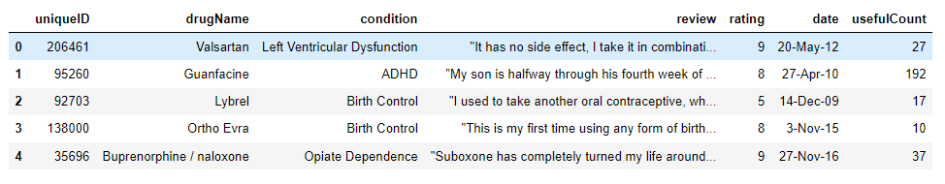
DRUG REVIEW DATASET

Slide 7
Data explanation
Variable description and identification
we can see total 7 variable and each variable has 161297 observations. Here comes the description of all variables:
uniqueID : An identifier for each post.
drugName : the name of the drug for which review made
condition : The name of the medical condition for which the medicine is used.
review: The review made by patients for a particular medicine.
rating: ratings, given by patients to each medicine on a scale of 10 where 10 represents the maximum efficancy
date: data of review entry.
usefulCount: The number of users who found the review useful.

Slide 8
Tools and Algorithms used for project
Programming Language: Choose Python for its robust NLP libraries.
NLP Libraries: NLTK, sklearn feature extraction.
Python Packages:
Pandas and NumPy for data analysis and calculation.
Matplot, Seaborn, Plotly for data Visualization.
Statsmodel and Sklearn for Machine learning.
Feature Extraction : sklearn feature extraction, sklearn_feature_selection.(SelectKBest, mutual_info_classif)
For Deployment: Visual Studio code, HTML and CSS

Slide 9
Data preprocessing using NLP
Natural language processing (NLP) is a subfield of artificial intelligence(AI).
Data preprocessing is a crucial step in natural language processing(NLP) that involves cleaning and transforming raw text data into a format that can be easily analyzed by machine learning algorithms.
NLP enables computers to understand natural language as humans do.
In this introduction, we will explore the importance of data preprocessing in NLP and some common techniques used for it.
once of the primary objective preprocessing is for remove any noise or irrelevant information from the text data.
This includes removing punctuation, stop words and special characters as we as correcting spelling error and normalizing text by converting it to lowercase.

Slide 10
Preprocessing
converted to lower
cleaning data(removing numbers, removing punctuations, removing stop words, removing url, removing whitespaces).
common words
Removing Emojis from Data
Lemmatization
Tokenization
TF-IDF
Model Building

Slide 11
Data Visualization

Slide 12
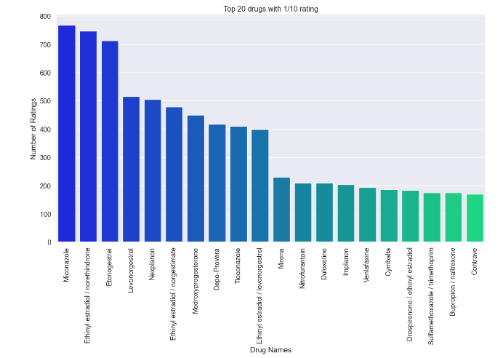
TOP 20 DRUGS WITH 1/10 RATING

Slide 13
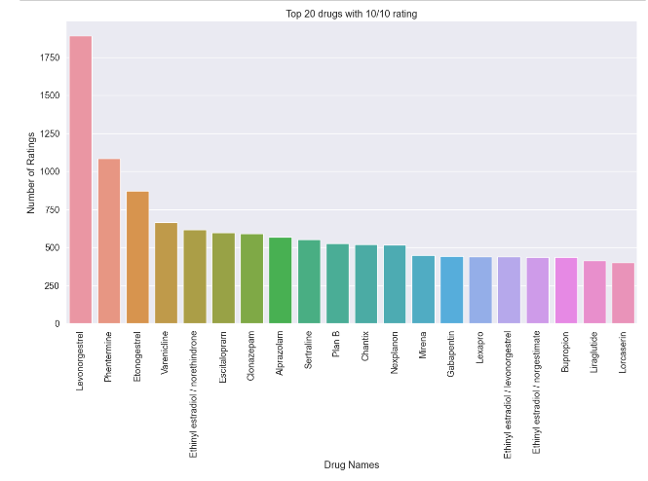
TOP 20 DRUGS WITH 10/10 RATING

Slide 14
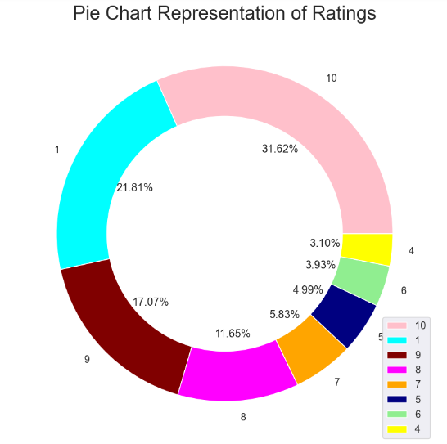
Representation of ratings

Slide 15
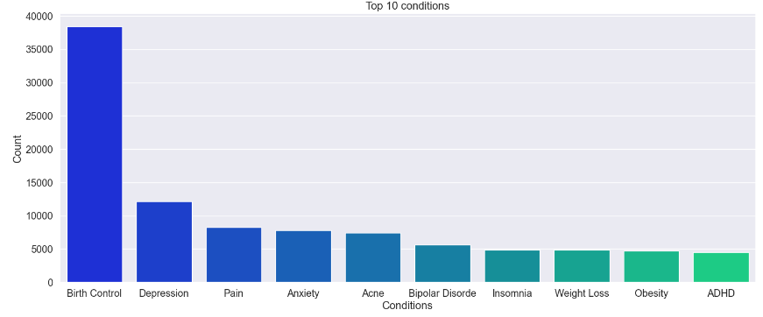

Slide 16
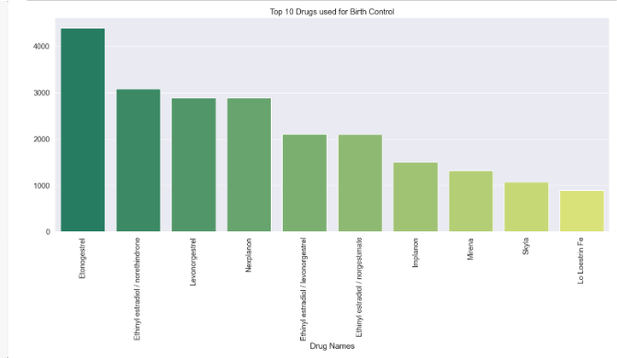

Slide 17
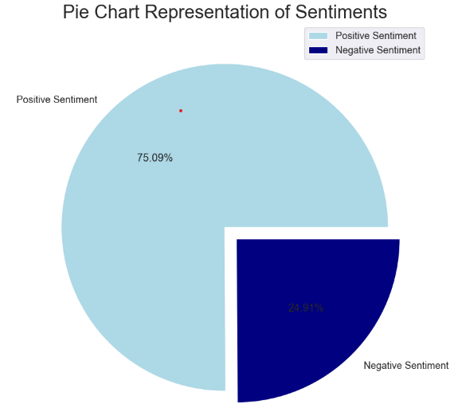

Slide 18
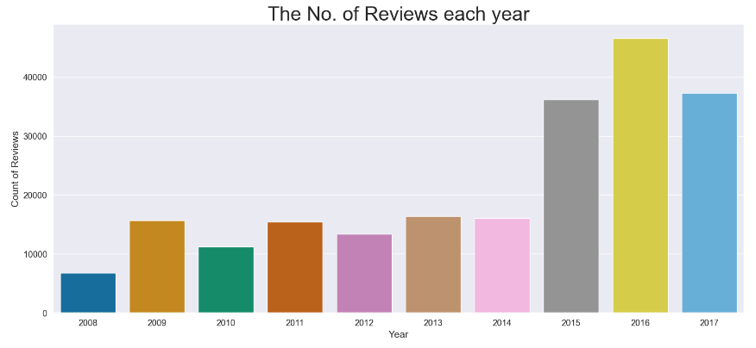
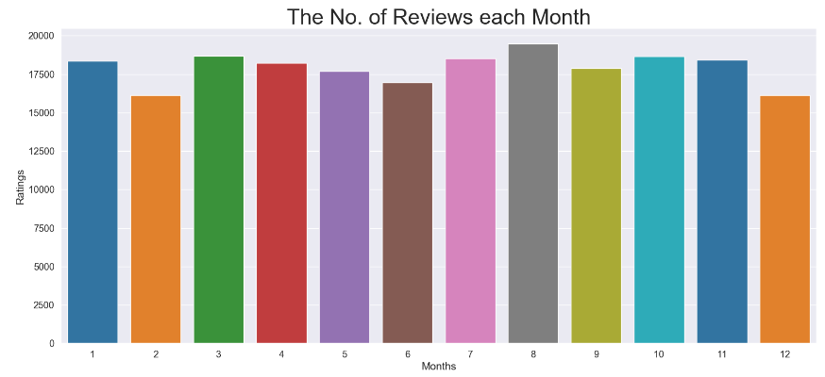

Slide 19
Word Cloud
A word cloud, also known as a tag cloud or text cloud, is a visual representation of text data in which the frequency or important if words is depicted through the size or color of the words

Slide 20
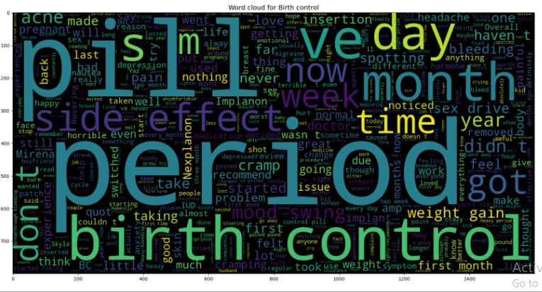

Slide 21
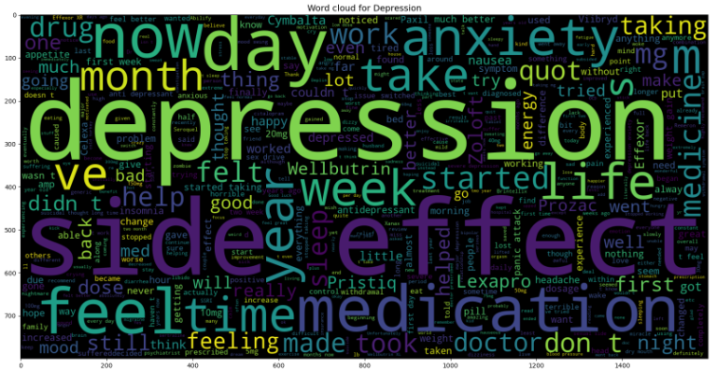

Slide 22
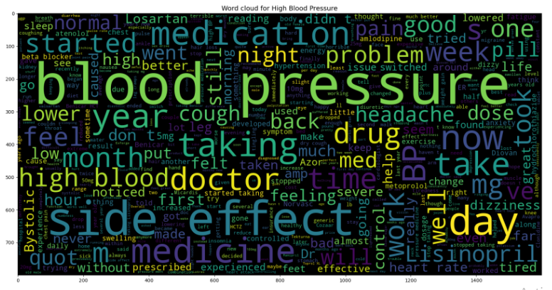

Slide 23
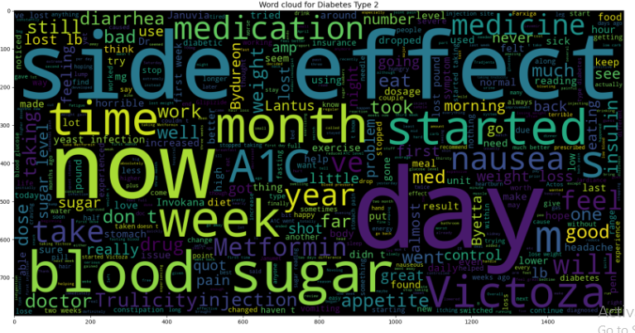

Slide 24
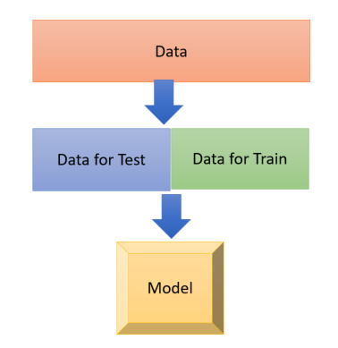
MODELING
To predict something useful from the datasets, we need to implement machine learning algorithms.
There are many types of algorithms like logistic regression, decision tree, random forest ,SVM , Naive Bayes etc. that can be used for modeling purpose.

Slide 25
PREDICTION
Once the model is trained, the prediction section allows the system to make drug recommendations for new input. The system takes the preprocessing data and passes it through the trained model to predict suitable drugs based on similarities to previous patients with similar conditions.
Moreover, building an actual drug recommendation system requires expertise in various fields, including machine learning , data preprocessing, web development and domain-specific medical knowledge.

Slide 26
Data Partition
Test dataset(30%)
Train dataset(70%)
Dataset
The data partition is done using train_test_split from sklearn library.
70% data is kept in train, whereas 30% is used for test

Slide 27
MODEL BUILDING
We performed various machine learning models in this dataset.
As the accuracy of logistic regression model is satisfactory for both train and test data, we chose results of that model to present.
the evaluation method is used for the project is confusion matrix.
S.R.NO | MODEL TYPE | TRAIN ACCURACY | TEST ACCURACY
1 | Logistic regression | 99% | 97%
2 | Decision tree | 97 | 95
3 | Random forest | 67 | 60
4 | PAC | 100% | 98%
5 | Naïve bayes | 97% | 92%

Slide 28
DEPLOYMENT

Slide 29
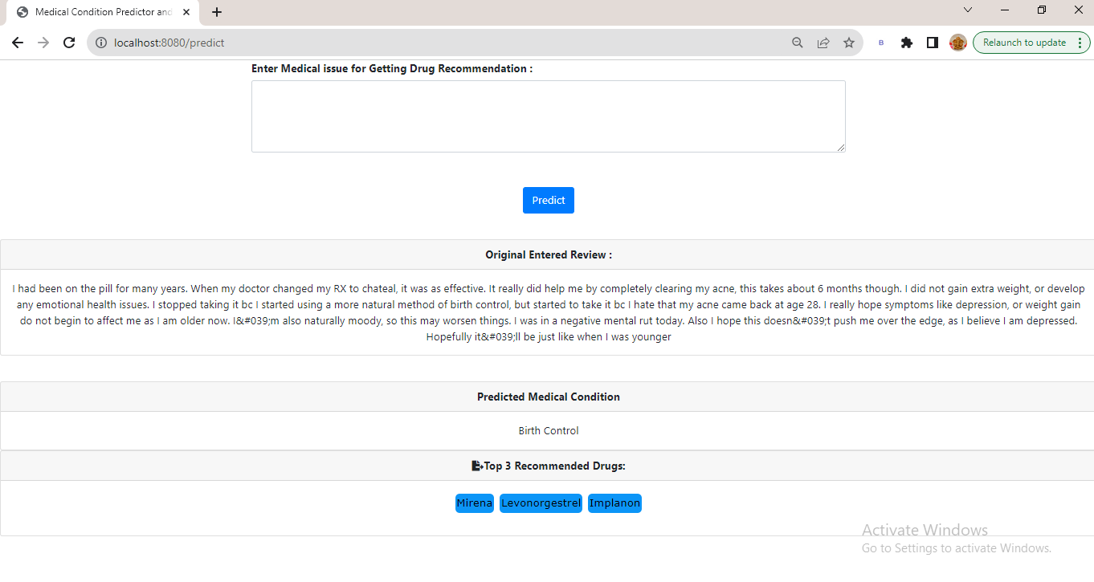

Slide 30
Challenges and its solution
the project faces the challenge of high dimensionality, which refers to a large number of features or variables in the dataset. High dimensionality can lead to computational inefficiency, increased complexity and potential over fitting of models.
To address this challenge , the project utilize the feature selection technique provided by the sklearn.feature_selection module in python.
And the last but the least was selecting the best model among the all models

Slide 31
Advantages
informed Decision making
Patient empowerment
Continuous improvement

Slide 32
Conclusion
In conclusion the drug recommendation system based on a machine learning algorithm for sentiment analysis of drug review holds great promise in improving healthcare outcomes.
the system ability to bridge the gap in healthcare access, especially in regions with limited medical resources, is a crucial advantage.
The model was developed using a variety of machine learning algorithms, including logistics, decision tree, random forest. The best performing algorithm was the logistic regression , which achieved and accuracy of 97%.

Slide 33
Word Cloud
A word cloud, also known as a tag cloud or text cloud, is a visual representation of text data in which the frequency or important if words is depicted through the size or color of the words

Slide 34
Scope
The drug recommendation system main objective is to provide personalized medications suggestions by analyzing user reviews .
this powerful tool can assist healthcare professionals in making informed decisions and empower patients with essential information about suitable medications.
one of its key advantages is the potential to bridge healthcare access gap, especially in underserved areas with limited medical specialists.
by efficiently processing a vast amount of drug review, the system can greatly improve the accuracy and efficiency of recommendation , benefiting both healthcare are providers and patients alike.

Slide 35
THANK YOU

